Slide 1
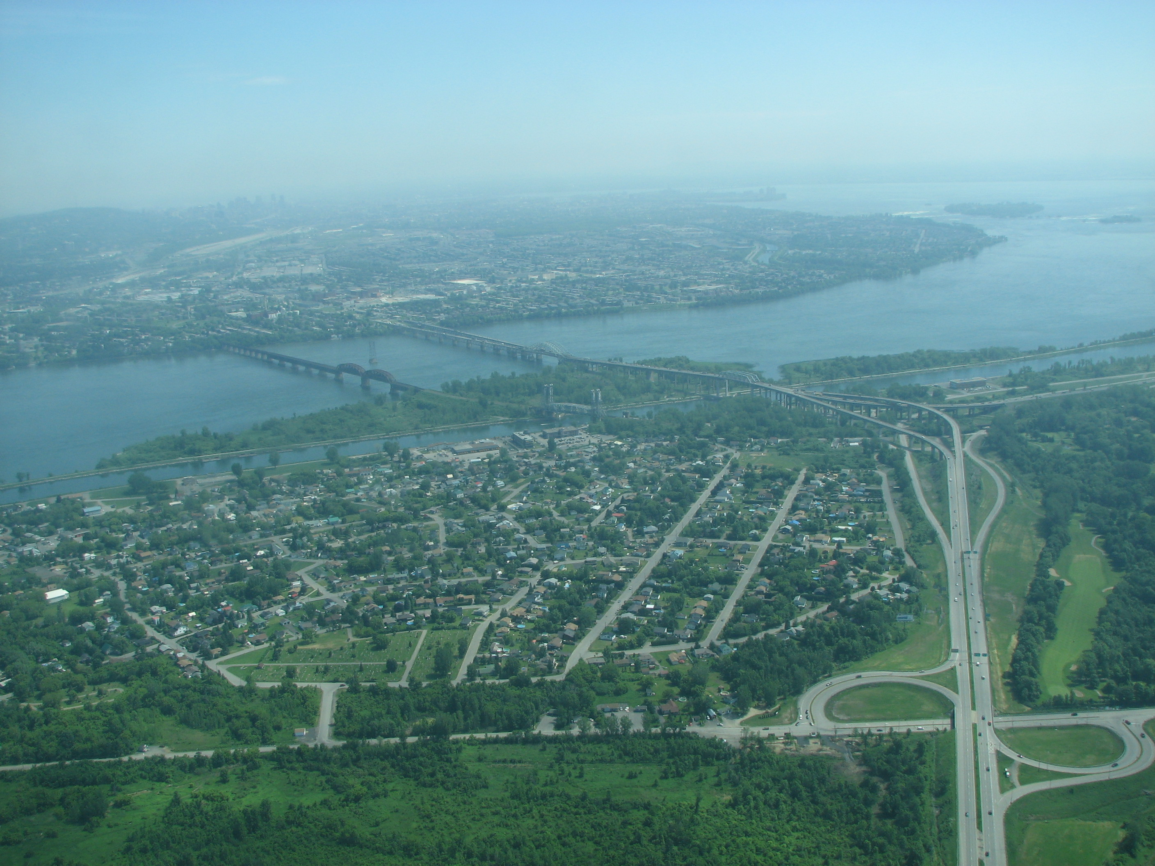

Kahnawà:ke’s Approach to Cannabis Legalization

Slide 2
Key points on Cannabis legalization
Cannabis is currently legal for medical purposes only
Medical cannabis can only be legally produced by Health Canada licensed producers and delivered via mail (i.e. Canada Post)
Cannabis will become legal for recreational use once the Cannabis Act comes into force on:
  October 17, 2018
After October 17, 2018, a Health Canada license will continue to be necessary to produce legal and licensed cannabis

Slide 3
Federal Cannabis Act
An Act respecting cannabis and to amend the Controlled Drugs and Substances Act, the Criminal Code and other Acts (also known as the Cannabis Act) comes into force on October 17, 2018
Purpose of Cannabis Act
  It imposes serious criminal penalties on people who break the law;
  establishes strict product safety and quality requirements;
  provides for the legal production of cannabis;
  allows adults to possess and access regulated, quality-controlled, legal cannabis;
  It delegates the authority to provinces to regulate sale/distribution in their respective provinces.

Slide 4
Key points on Cannabis legalization
In order to be an authorized producer/seller of cannabis, you need to have a Health Canada license, otherwise you are liable to stiff criminal penalties, including:
  Possession over the limit – up to 5 years in prison
  Illegal distribution or sale – up to 14 years in prison
  Illegal cannabis production – up to 14 years in prison
  Taking cannabis across the border – up to 14 years in prison
  Giving or selling cannabis to someone under the age of 18 – up to 14 years in prison
  Using a youth to commit a cannabis related offence – up to 14 years in prison
Cannabis-related offences could also lead offenders from being barred entry to the United States as cannabis is still illegal federally in the U.S.

Slide 5
Applicability of the Cannabis Act To Kahnawà:ke
Cannabis Act applies to the Mohawk Territory of Kahnawà:ke
  Kahnawà:ke cannot escape the application of the Cannabis Act
  The Peacekeepers have the obligation to enforce the criminal laws of general application
  The Cannabis Act is a criminal law of general application, which includes very serious criminal sanctions
  Given that cannabis is a drug, the PKs will enforce the criminal laws with respect to illegal and unlicensed cannabis within the Territory even after legalization

Slide 6
What will be legal once the cannabis Act comes into force?
Adults who are of legal age (depending on the province), will be able to legally:
  purchase limited amounts of fresh cannabis, dried cannabis, cannabis oil, cannabis seeds, or cannabis plants from retailers authorized by the provinces;
  possess up to 30 grams of dried legal cannabis or equivalent in non-dried form in public;
  consume cannabis in locations authorized by local jurisdictions;
  share up to 30 grams of dried cannabis or equivalent with other adults;
  make legal cannabis-containing products at home, such as food and drinks, provided that dangerous organic solvents are not used in making them.

Slide 7
Applicability of Quebec cannabis regulation act to Kahnawà:ke
Each province is responsible for regulating distribution/sale of cannabis
Quebec is implementing an SAQ-type model to regulate and manage sale of cannabis in the province
Quebec’s cannabis regulations will not apply in Kahnawà:ke
Kahnawà:ke will regulate cannabis sale/distribution on the Territory and ensure that all cannabis produced, processed, distributed and sold in Kahnawake is licensed by Health Canada

Slide 8
Council decisions on cannabis legislation
Appointment of Cannabis Working Group:
  Legislative drafting team responsible for drafting of KCCL
  Exploration of socio-economic opportunities for communal benefit
MCED No. 48/2017-2018:
  Moratorium on the distribution and sale of cannabis for profit
  Moratorium to be rescinded and replaced by the Kahnawake Cannabis Control Law

Slide 9
Council decisions on cannabis legislation
MCED No. 61/2017-2018:
  Designated Type II regulatory legislation
  Purpose and scope of the Kahnawake Cannabis Control Law:
    Ensure health and safety of the community, first and foremost;
    Establish a licensing process for production, distribution, and sale;
    Harmonize the licensing process for the production of cannabis with the licensing process overseen by Health Canada;
    Establish criteria for the eligibility of licenses;
    Establish a regulatory body to be appointed by Chief & Council mandated to regulate all aspects of the cannabis industry;
    Ensure that the community receives tangible socio-economic benefits from the proceeds received from any cannabis operations within the Territory.

Slide 10
PREPARATION FOR Cannabis LEGALIZATION
Consultation:
  Agenda item at community 3 meetings, community technical survey
  Special community meeting 23 Oct. 2017, numerous community notices, postings of KCCL, FAQs, feedback report
  Community presentation: Canadian Legal Framework
  Kahnawà:ke Peacekeepers/Public Health and Safety
  KSCS, KMHC, Santé Cannabis, Kahnawà:ke Justice Commission, Tewatohnhi'saktha , Academie de Gestion
  Business information session Dec. 2017
  AFNQL, Thunderbird Foundation, other First Nations
  Licensed & pre-licensed producers (including site visits)
  Conferences (i.e. O’Cannabiz Conference, McGill University – Institute for Health and Social Policy’s cannabis conference)
  Federal/provincial gov’t (i.e. Bill Blair)

Slide 11
Key Takeaways from Kahnawà:ke Technical Survey 2017
1700 people called, 268 responded (90% confidence rate)
57% supported creating local Cannabis Law (31% opposed)
45% supported recreational sales on territory (42% opposed, 13% had no opinion)
52% supported production in Kahnawà:ke with sale outside of the community (35% opposed)
41% supported off-territory investment (46% opposed)

Slide 12
Made-for-Kahnawake solution to cannabis legalization
Overall objective of KCCL is to assert local control and ensure there will not be unilateral imposition of laws by Canada and Quebec
KCCL is to ensure local control of cannabis industry given lack of zoning laws
KCCL will displace provincial laws with respect to distribution and sale of cannabis on the Territory
Kahnawà:ke will establish its own self-governing institutions to ensure health and safety of the community

Slide 13
Kahnawà:ke Cannabis Control Law
Two-tiered licensing system:
  Both Health Canada and Kahnawà:ke licenses are required in order to operate in the Territory
KCCL will regulate:
  Cultivation
  Processing
  Distribution
  Sale and
  Possession

Slide 14
Kahnawà:ke Cannabis Control Law
Kahnawà:ke is invoking the exclusive right and jurisdiction to regulate and control cannabis within its Territory
Jurisdiction:
  Right to self-government
  Right to self-determination
  Rights as affirmed and recognized under s. 35 of the Constitution Act, 1982
  Rights as recognized and affirmed under the United Nations Declaration on the Rights of Indigenous Peoples

Slide 15
Kahnawà:ke Cannabis Control Law
Purpose of the KCCL:
  Ensure health and safety of community (especially youth)
  protect the jurisdictional integrity of the Territory
  Promote and enhance socio-economic development, fiscal self-sufficiency and tangible benefits for Kahnawà:ke

Slide 16
Kahnawà:ke Cannabis Control Law
Purpose cont’d
  Provide for quality-controlled cannabis
  Deter illicit and illegal activities in relation to cannabis
  Balance the interests of Kahnawà:ke community members who remain divided on the production and sale of cannabis on the Territory

Slide 17
Kahnawà:ke Cannabis Control Law
Applicability:
  Applies to all persons within the Mohawk Territory of Kahnawà:ke
  May apply to Tioweró:ton Territory
    Kahnawà:ke and Kanehsatà:ke must jointly agree to apply all or part of KCCL to Tioweró:ton

Slide 18
Kahnawà:ke Cannabis Control Law
Possession
  Cannabis must be purchased from a licensed dispensary
  Must not exceed amount prescribed by regulation (i.e. 30 g)
Prescribed legal age for purchase of cannabis in Kahnawà:ke
  Currently set at 21 years of age
No cultivation of household plants
Rules on consumption in public
  No consumption in public areas

Slide 19
Kahnawà:ke Cannabis Control Law
Possession by medical patients
  KCCL does not impose any restrictions on persons requiring cannabis for medical purposes
  Medical prescription supersedes the application of KCCL

Slide 20
Kahnawà:ke Cannabis Control Law
Creation of two new bodies:
  Cannabis Control Board:
    Issue, suspend and revoke licenses
    Regulate, monitor and inspect
    Wide discretion to take any action necessary to fulfill purpose of the KCCL
  Health and Safety Committee:
    Will recommend number of licenses to issue in Territory
    Will recommend regulations to be adopted by Control Board

Slide 21
Kahnawà:ke Cannabis Control Law
Types of licenses available:
  Standard Cultivation License
  Micro-cultivation License
  Standard Processing License
  Micro-processing License
  Distribution License
  Dispensary License
  And such other license category that the Board may create by regulation

Slide 22
Kahnawà:ke Cannabis Control Law
Standard cultivation/processing license:
  Only available to a community-owned or empowered entity
  Entire community must benefit from a large-scale facility
Micro-cultivation/micro-processing licenses:
  Individual community members eligible to apply for micro-cultivation/micro-processing licenses

Slide 23
Kahnawà:ke Cannabis Control Law
Dispensary:
  Quebec’s cannabis distribution model not applicable to the Territory
  Instead, a Health Canada & Kahnawà:ke retail license will be required
  Nevertheless, Kahnawà:ke will maintain strict standards (i.e. labelling, testing, licensing, etc.) and authorize Health Canada to ensure conformity with federal standards

Slide 24
Kahnawà:ke Cannabis Control Law
Standards & Testing
  Health Canada testing standards apply
  Health Canada has developed uniform testing standards for cannabis at recognized laboratories
  Kahnawà:ke does not have the technical capacity or expertise to conduct testing at this time
  Cannabis Control Board will ensure that any cannabis cultivated, processed, and sold in the community adheres to Health Canada’s standards
Packaging & labelling
  Must follow all Health Canada requirements
  Will make product easy to track

Slide 25
Kahnawà:ke Cannabis Control Law
Point of Sale Non-Onkwehón:we Royalty
  No sales tax
  Royalty will not be remitted to external tax authorities
  Royalty is to avoid the imposition of sales tax if/when CRA/Revenue Quebec request the imposition of sales tax on cannabis
  Royalty to be used for community initiatives, such as socio-economic projects, drug prevention and education initiatives

Slide 26
Kahnawà:ke Cannabis Control Law
Mandatory Community Contributions
  License holders may be required to pay a community contribution
  Contribution will be used to cover:
    Administrative costs of regulating cannabis
    Upgrades to community infrastructure
  Cultivation is a significant drain on community resources (i.e. land, water treatment, electricity, etc.)
  Community infrastructure (i.e. water treatment facility, utilities, water pipes, etc.) will require significant upgrades in order to sustain a local cannabis industry

Slide 27
Kahnawà:Ke Cannabis Control Law
Enforcement:
  Breaches of law or regulations will result in sanctions by Cannabis Control Board
  Peacekeepers will apply penal/criminal laws for unlicensed cannabis activities and enforce criminal laws of general application
  Anyone producing, selling, or distributing cannabis without both a Health Canada and Kahnawà:ke license will be operating illegally under KCCL

Slide 28
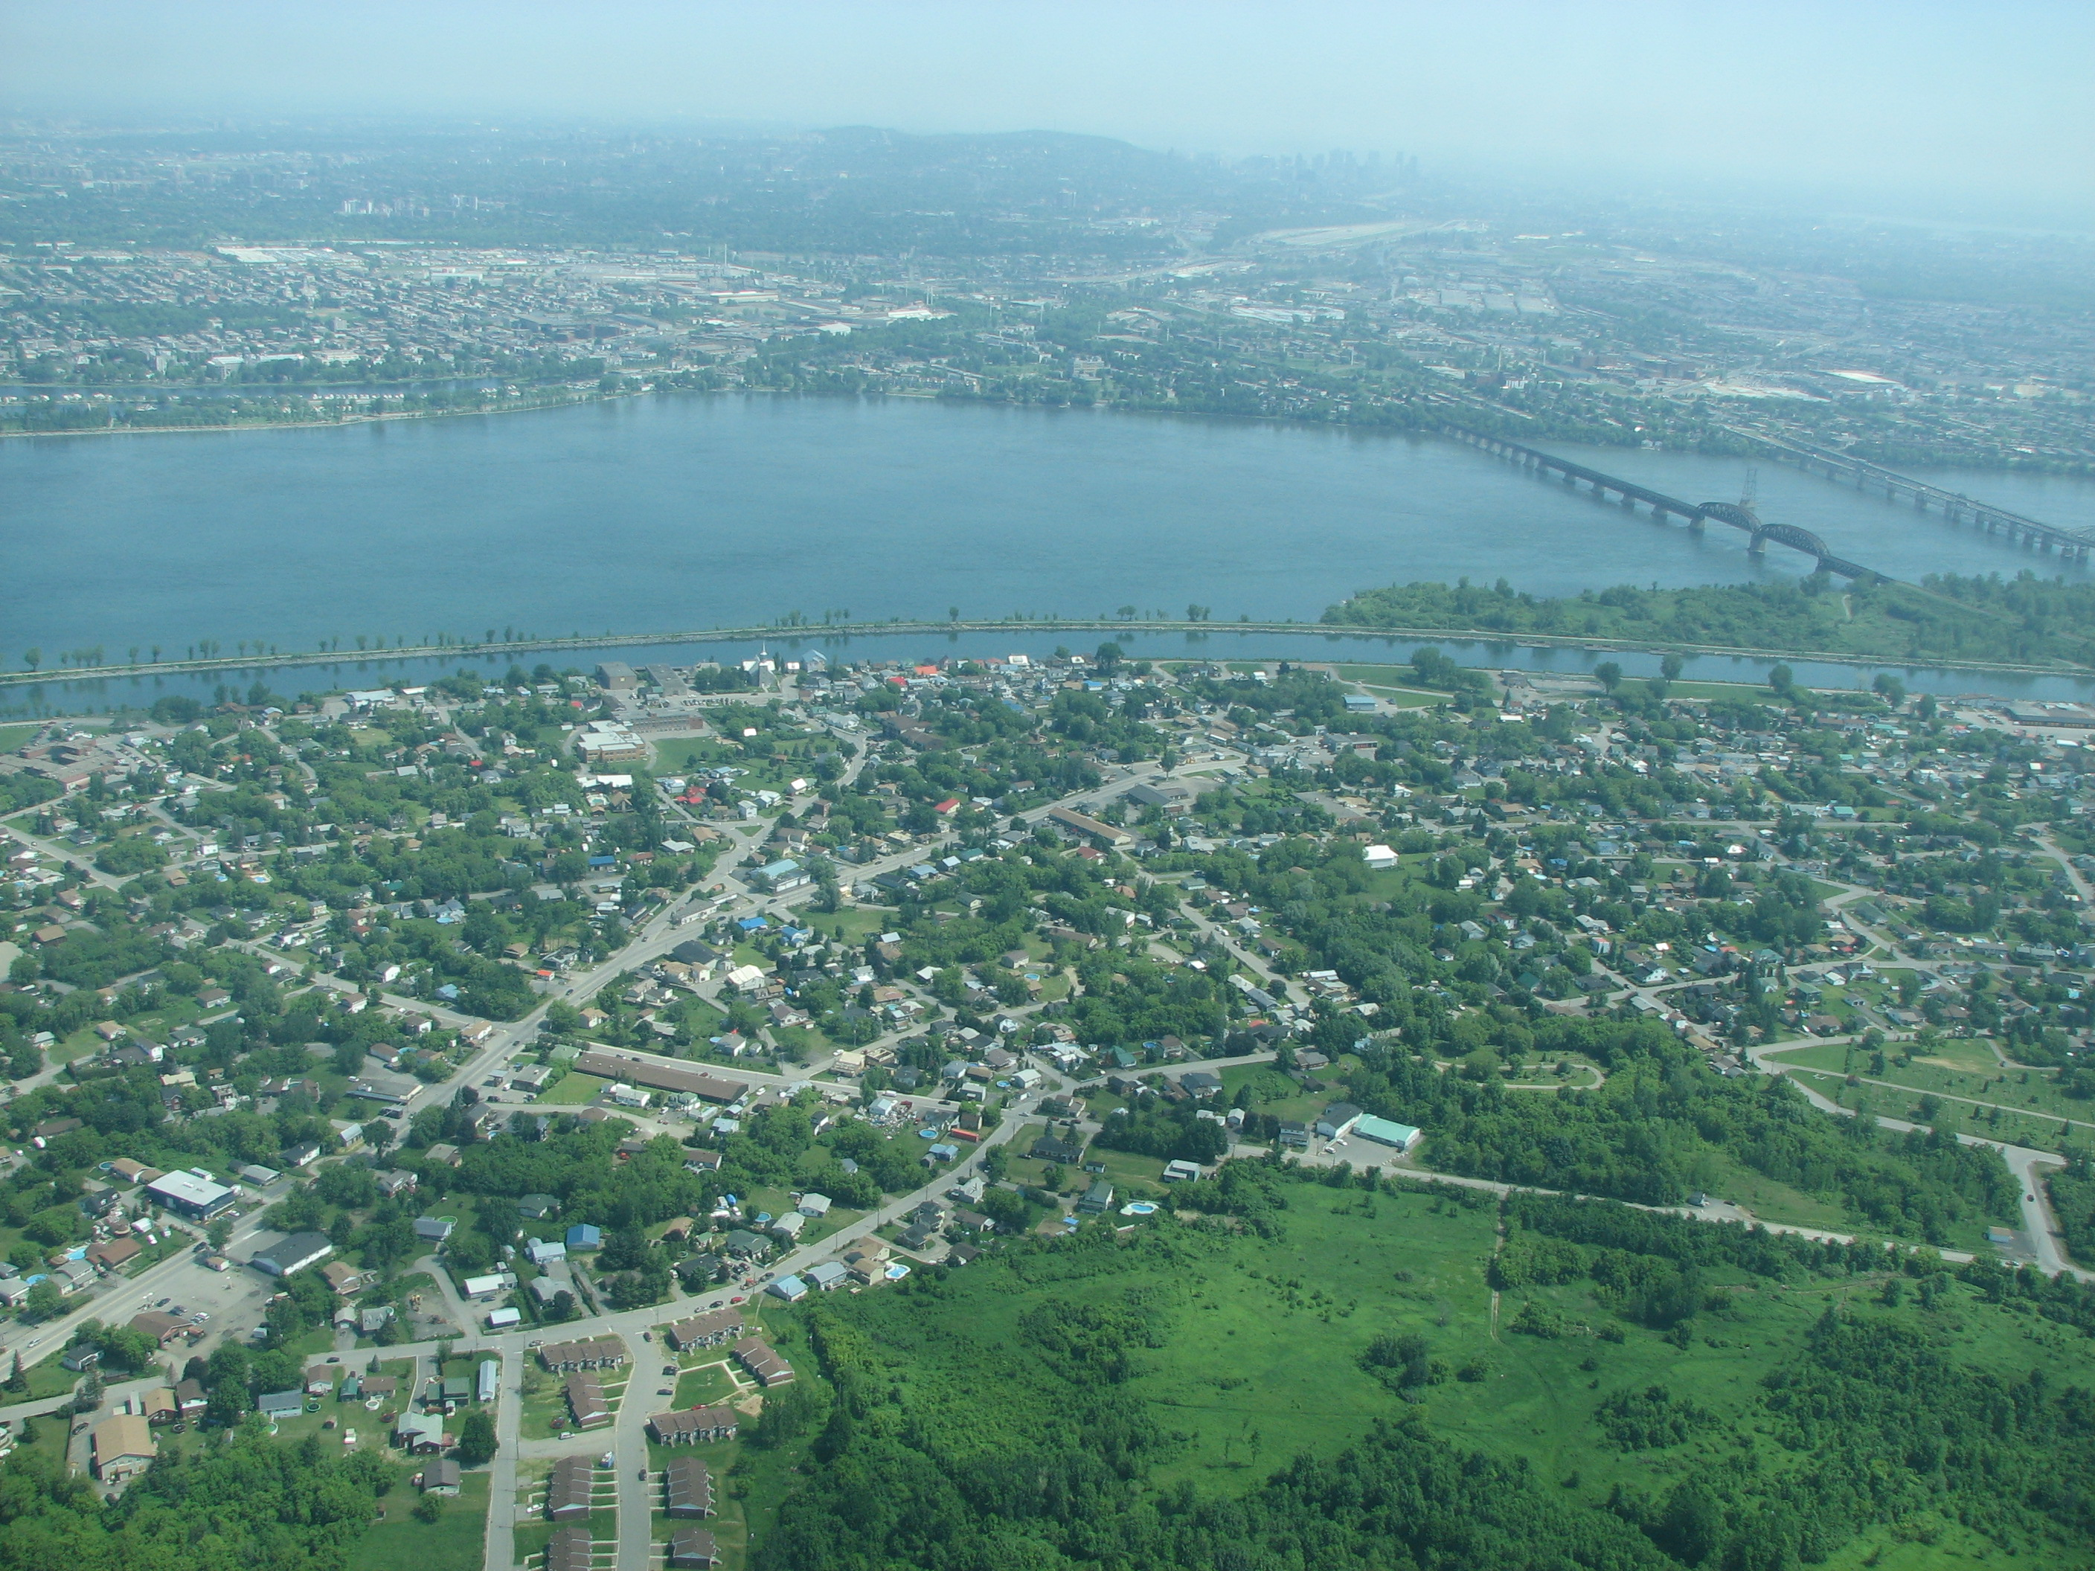
Niá:wen

